Slide 1

EGRET enhancements in 2018: EGRET 3.0.2 and EGRETci 2.0.3
Robert M. Hirsch
Research Hydrologist Emeritus
March 27, 2019

Slide 2
Topical Outline
Consideration of discharge trends on water quality trends
New types of results and displays for water quality trends
New types of displays of discharge trends
Evaluation of impacts of point source upgrades

Slide 3
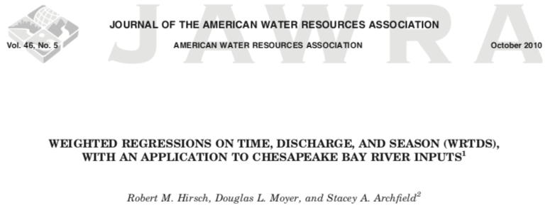
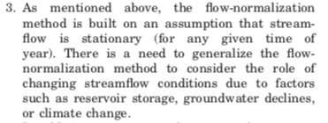
Topic 1: discharge trend
Original WRTDS paper in 2010 mentioned 7 remaining areas of potential improvement of method (5 of the 7 have been worked on, 4 have approved code).

Slide 4
Let’s do a thought experiment
Say we just want to compute the change in nitrate concentration between these two dates: 1987-04-01 and 2017-04-01, for Choptank
WRTDS gives us a smooth curve for each of these dates. It is E[Conc] = f(Q) which we can visualize with plotConcQSmooth

Slide 5
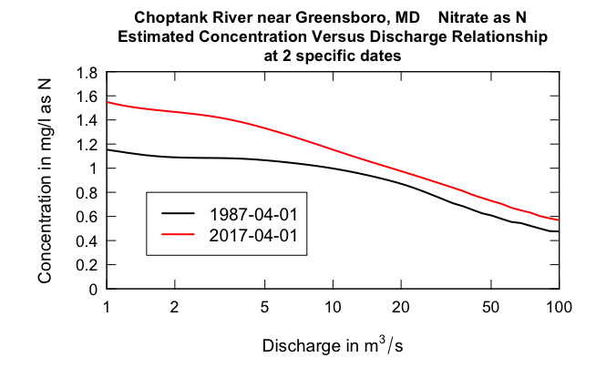

Slide 6
What does it tell us?
Fairly large increase at lower flows, small increase at high flows
Flow-normalization allows us to take an average of those differences, based on the differences at each of the observed April 1 discharges.
It looks like this.

Slide 7
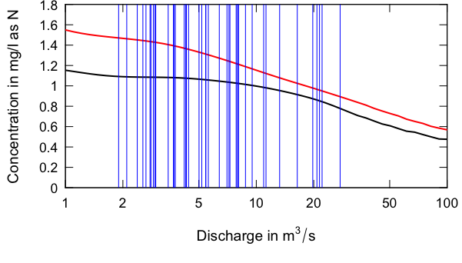
Each blue line is a Q that happened on some April 1 between 1974 and 2017
The change in E[C], for April 1 between 1987 and 2017 is the average of the vertical differences on all the blue lines

Slide 8
The 1987-04-01 mean is 1.05 mg/L, the 2017-04-01 mean is 1.27 mg/L.
Thus, the change in FN-Concentration between these dates is +0.22 mg/L

Slide 9
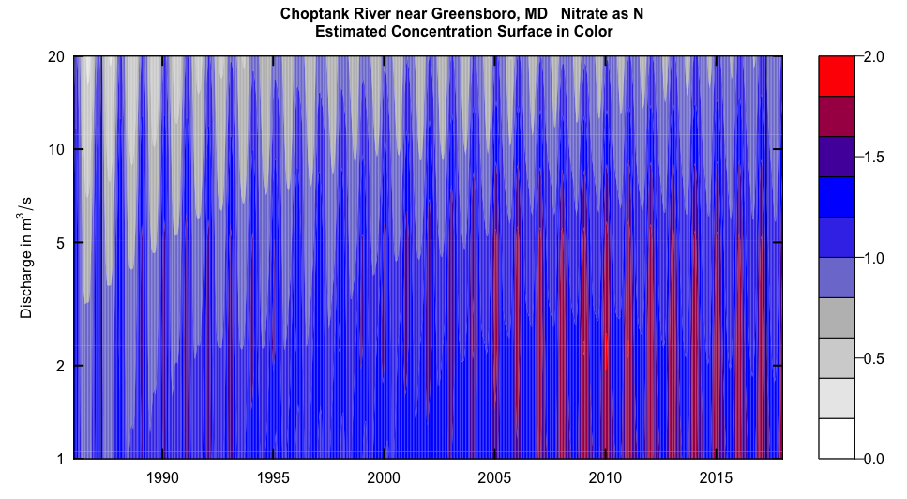
We can do that process 365 times to get the change specific to each day of the year.
April 1, 1987
April 1, 2017
Think of the contour plot as being made up of 11,680 individual daily curves:
E[C] = f(Q)
Interpolated from 512 such curves

Slide 10
We can do that process 365 times to get the change specific to each day of the year.
We could sum these 365 change values to get an integrated measure of change between the years.
We could also repeat it for flux, changing the curves to be E[Flux] = f(Q) * Q

Slide 11
Continuing the thought experiment: what if the early years of the record had discharges around 20 to 30 m³/s and the later part were all around 2 to 3 m³/s
The change in flow-normalized concentration would be much bigger
Later years
Early years

Slide 12
This is absurdly extreme case, but we know that flow distributions do change
We want to use a sample of flows for any given day, that we think are representative of the flow distribution around that year.

Slide 13
The set of discharges used in this averaging process (which we call flow-normalization) at the beginning of our period of record no longer seem reasonable toward the end, why?
Tile drains
Groundwater depletion
More intense precipitation
Interbasin transfers
A new dam
A dam removed
???

Slide 14
What is our alternative?
“Generalized Flow Normalization”
It is contrasted with “Stationary Flow Normalization” which is what we have all been using
Now in EGRET 3.0 (and EGRETci 2.0)

Slide 15
Three ways of characterizing the Q nonstationarity
A “flowBreak” (an abrupt change)
“windowSide” (moving window for Q)
Combination of the two
With windowSide = 9, we are using a 19-year window of discharge values to represent the distribution of Q

Slide 16
Three modes for running it?
runPairs (compares any two years)
runSeries (computes a complete record)
runGroups (compares two groups of consecutive years)

Slide 17
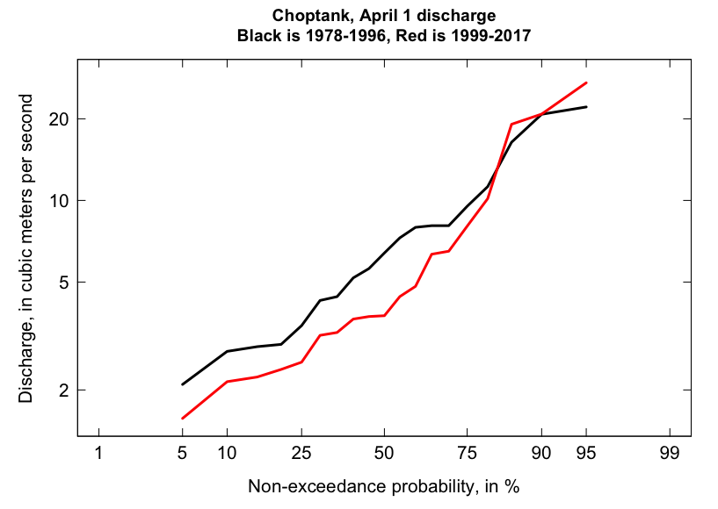
Back to the thought experiment:
What set of April 1 data to use for 1987 versus 2017, with windowSide = 9
For 1987 use the years 1978, 1979, …, 1996
For 2017 use the years 1999, 2000, ...., 2017
a 50% drop
at the median

Slide 18
Let’s try it
pairsOut <- runPairs(eList, 1987, 2017, windowSide = 9, oldSurface = TRUE)
Choptank River near Greensboro, MD
Nitrate as N
Water Year
Change estimates 2017 minus 1987
For concentration: total change is 0.323 mg/L
expressed as Percent Change is 31 %
Concentration v. Q Trend Component 33 %
Q Trend Component -1.9 %

Slide 19
Change estimates 2017 minus 1987
For concentration: total change is 0.323 mg/L
expressed as Percent Change is 31 %
Concentration v. Q Trend Component 33 %
Q Trend Component -1.9 %
For flux: total change is 0.0458 million kg/year
expressed as Percent Change is 39 %
Concentration v. Q Trend Component 27 %
Q Trend Component 12 %
TotalChange CQTC QTC x10 x11 x20 x22
Conc 0.323 0.344 -0.020 1.04 1.05 1.38 1.37
Flux 0.046 0.032 0.014 0.12 0.12 0.16 0.16
Things you would see in the tableChange command are in the green boxes

Slide 20
> seriesOut <- runSeries(eList,windowSide = 9, oldSurface = TRUE) The surface you are using extends 11 years prior to the start of the water quality data set. Extension of more than about a year is not recommended. > plotConcHist(seriesOut)

Slide 21
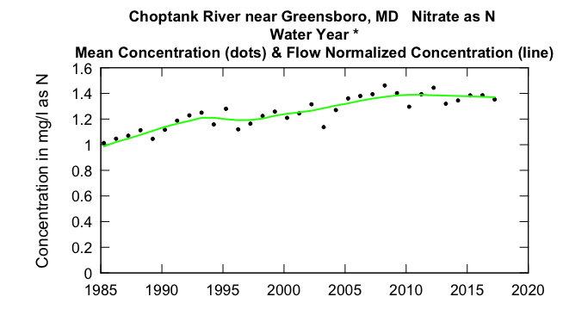

Slide 22
A digression: lets talk about characterizing the discharge change
We aren’t running trend tests
We aren’t pre-judging if discharge change is important to water quality – we use Generalized Flow Normalization to see if it matters
But, we may want a graphical characterization of the discharge trend

Slide 23
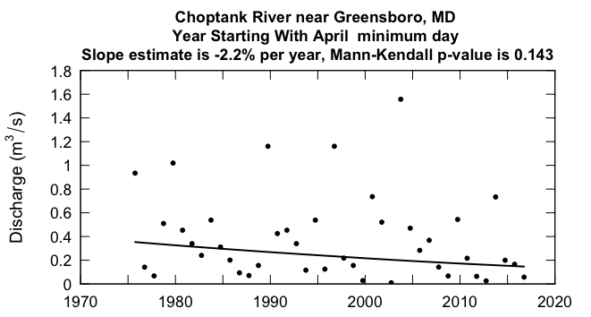
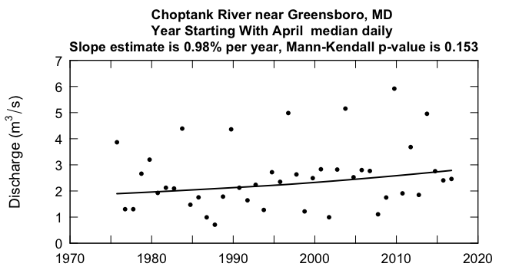
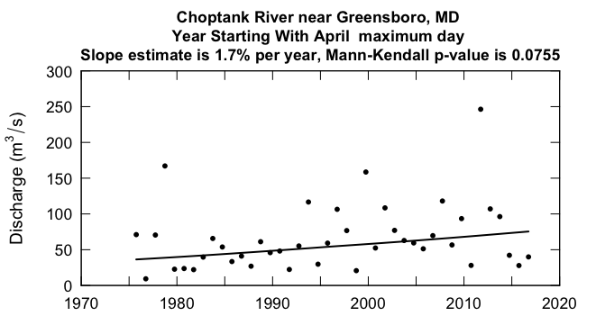
Flow trends at Choptank 1974-2017

Slide 24
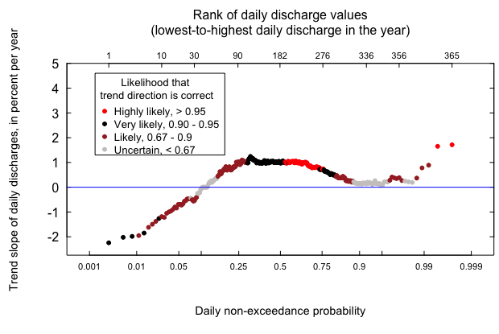
Bring the trend results together with a Quantile-Kendall Plot
Choptank 1974 - 2017

Slide 25
Now back to another analyte at Choptank
Orthophosphorus

Slide 26
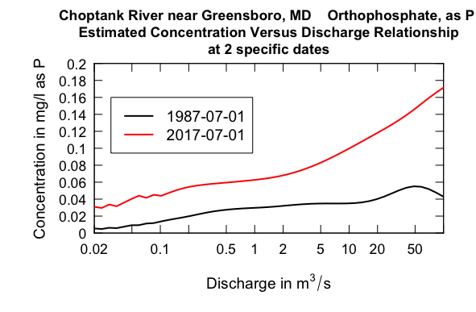
Ortho P at Choptank
Big differences at high discharge

Slide 27
runPairs results
Choptank River near Greensboro, MD
Orthophosphate, as P
Water Year
Change estimates 2017 minus 1987
For concentration: total change is 0.0217 mg/L
expressed as Percent Change is 115 %
Concentration v. Q Trend Component 109 %
Q Trend Component 6.5 %
For flux: total change is 0.0051 million kg/year
expressed as Percent Change is 199 %
Concentration v. Q Trend Component 135 %
Q Trend Component 64 %

Slide 28
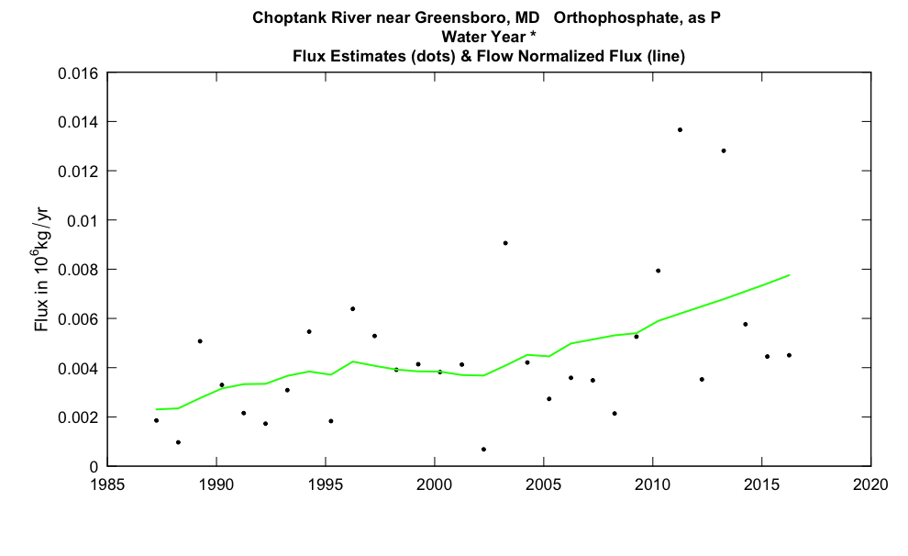
A big deal in my opinion. Do other Delmarva sites show something similar?

Slide 29
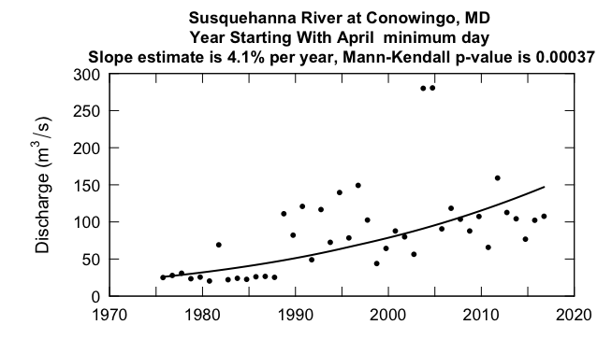
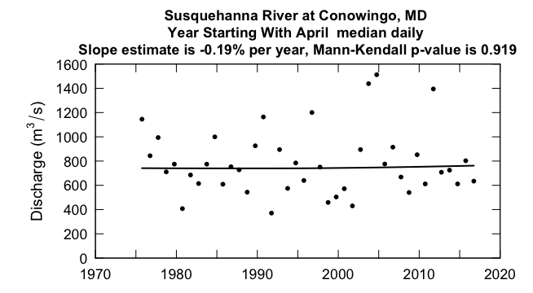
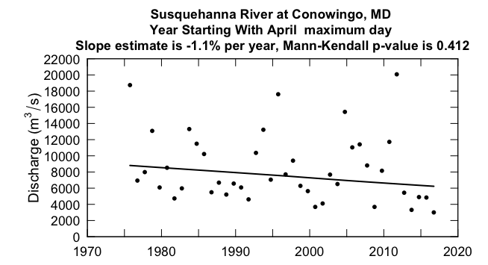
Flow trends at Conowingo 1974-2017

Slide 30
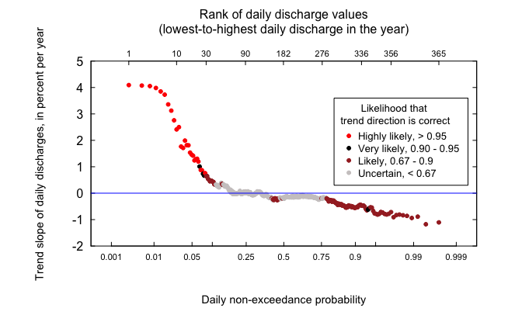
Bring the trend results together with a Quantile-Kendall Plot
Conowingo 1974 - 2017

Slide 31
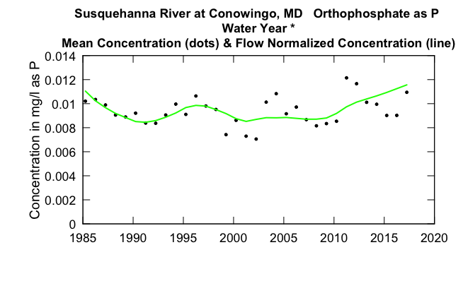
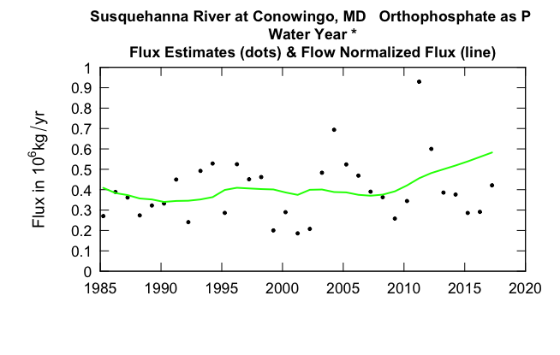
Let’s go to orthophosphate at Conowingo
Another really big deal

Slide 32
runPairs results
Susquehanna River at Conowingo, MD
Orthophosphate as P
Water Year
Change estimates 2017 minus 1987
For concentration: total change is 0.0019 mg/L
expressed as Percent Change is 20 %
Concentration v. Q Trend Component 18 %
Q Trend Component 1.7 %
For flux: total change is 0.209 million kg/year
expressed as Percent Change is 56 %
Concentration v. Q Trend Component 58 %
Q Trend Component -1.7 %

Slide 33
runPairs results This time just 2007-2017
Susquehanna River at Conowingo, MD
Orthophosphate as P
Water Year
Change estimates 2017 minus 2007
For concentration: total change is 0.00286 mg/L
expressed as Percent Change is 33 %
Concentration v. Q Trend Component 33 %
Q Trend Component 0.044 %
For flux: total change is 0.212 million kg/year
expressed as Percent Change is 57 %
Concentration v. Q Trend Component 62 %
Q Trend Component -4.7 %

Slide 34
Orthophosphate as P,
difference contours 1987 – 2017, Conowingo
Discharge, in thousands of cfs

Slide 35
Site | Analyte | Metric | Stationary | Generalized
Choptank | Nitrate | Concentration | + 33% | + 31%
Choptank | Nitrate | Flux | + 27% | + 39%
Choptank | Ortho P | Concentration | + 109% | + 115%
Choptank | Ortho P | Flux | + 135% | + 199%
Conowingo | Ortho P | Concentration | + 18% | + 20%
Conowingo | Ortho P | Flux | + 58% | + 56%
Trends for 1987 - 2017

Slide 36
General comments (based on my work and Jenny Murphy’s work with NAWQA results)
At time scales like 30 years, sometimes GFN matters a lot and sometimes it doesn’t
If it matters, it matters most for flux and not concentration

Slide 37
What do we know about flow trends throughout the Chesapeake Bay watershed?
Choptank Q shows modest increases at medium and very high flows, decreases at low flows.
Conowingo Q shows increases at low flow (driven by dam operations) but at moderate to high flows it is slightly downward.
What about another tributary in the lower Susquehanna?

Slide 38
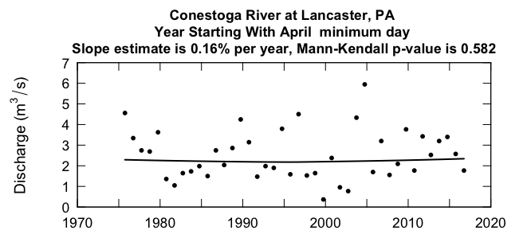
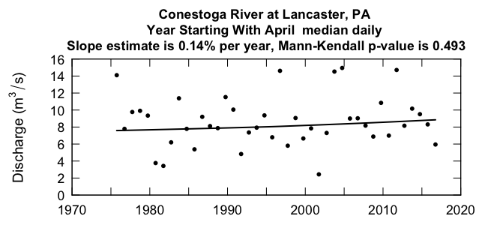
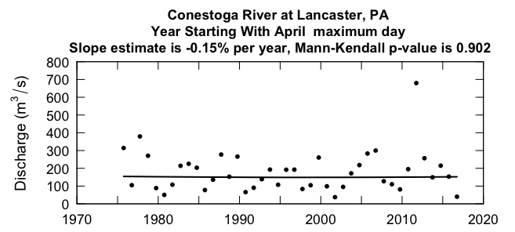
Flow trends at Conestoga 1974-2017

Slide 39
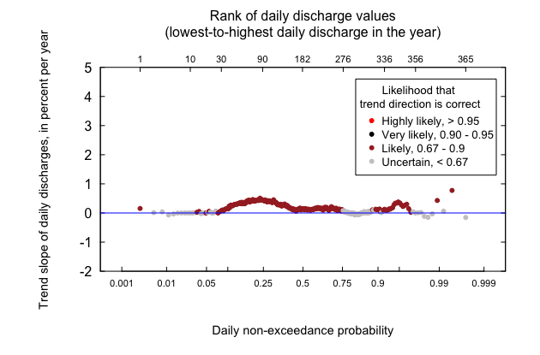
Bring the trend results together with a Quantile-Kendall Plot
Conestoga at Lancaster 1974 - 2017
Zilch!

Slide 40
Major limitations of GFN
Except for some cases of flowBreak, most of these flow changes are subtle and gradual
It is folly to try to use the moving windows to characterize the flow trends for records < 20 years
The “windowSide” is another parameter, like windowQ or windowY that is set by judgment.
Not perfect. Better than assuming stationarity??

Slide 41
Ways of displaying results
Examples from the Lake Erie report, in review for Journal of Great Lakes Research (Choquette, Hirsch, Murphy, Johnson, and Confessor)

Slide 42
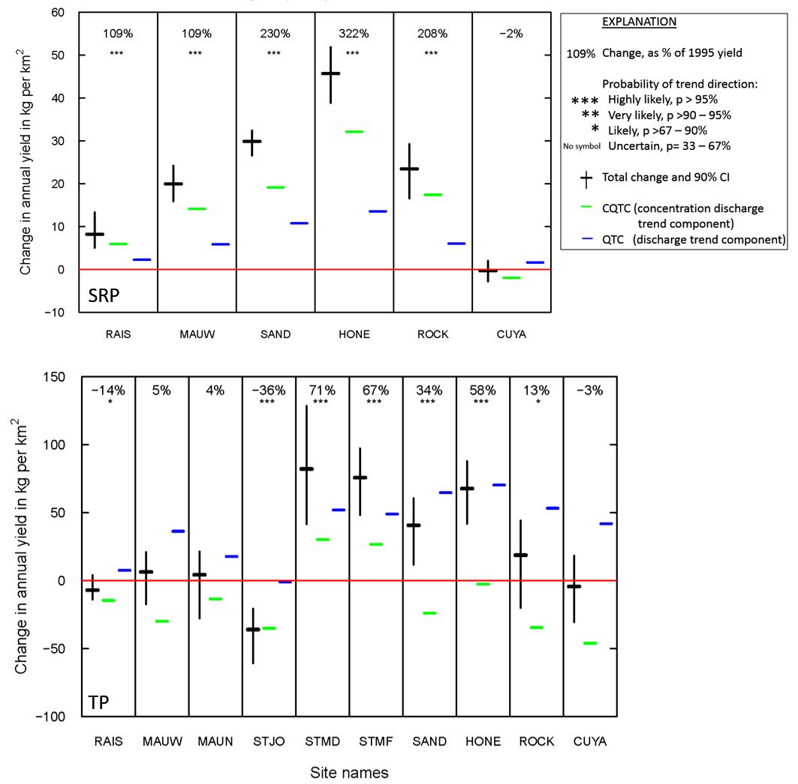

Slide 43
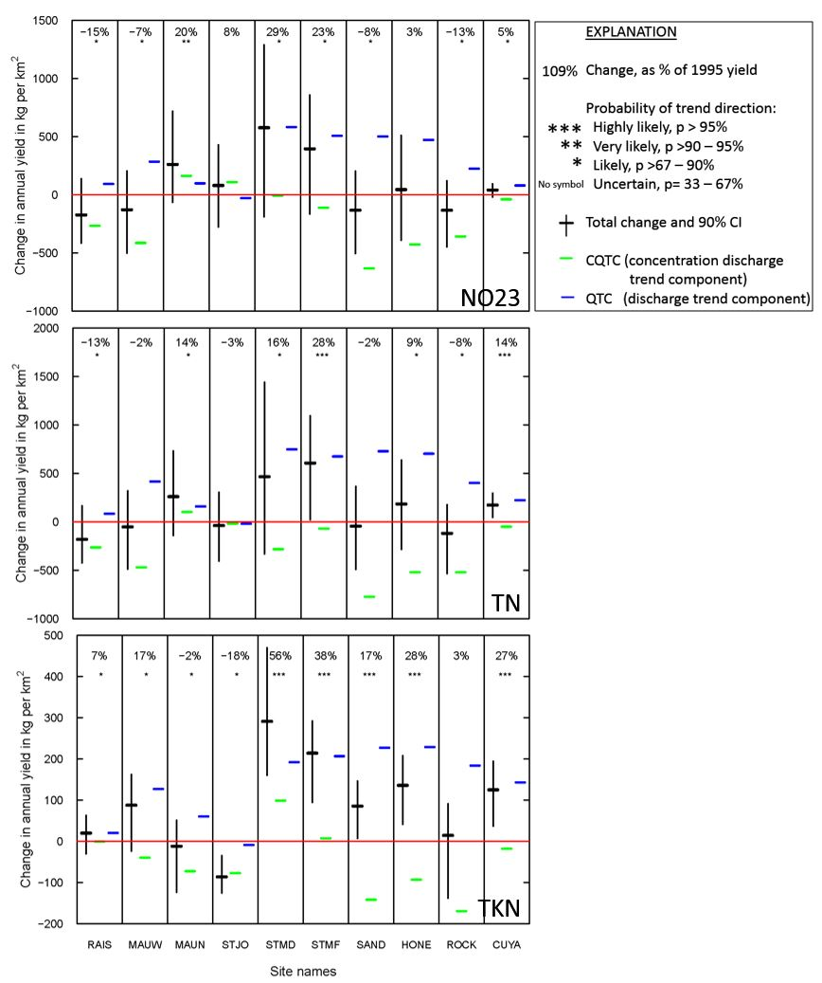

Slide 44
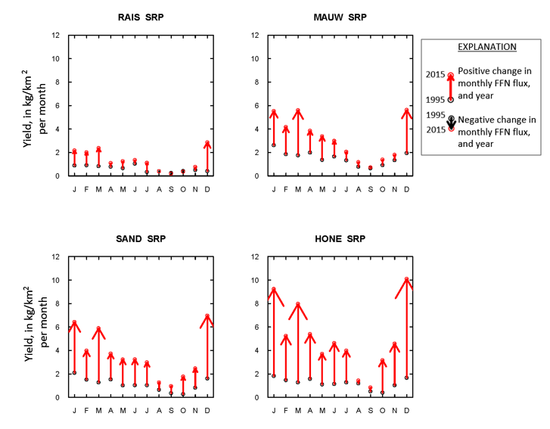
Yield changes by month

Slide 45
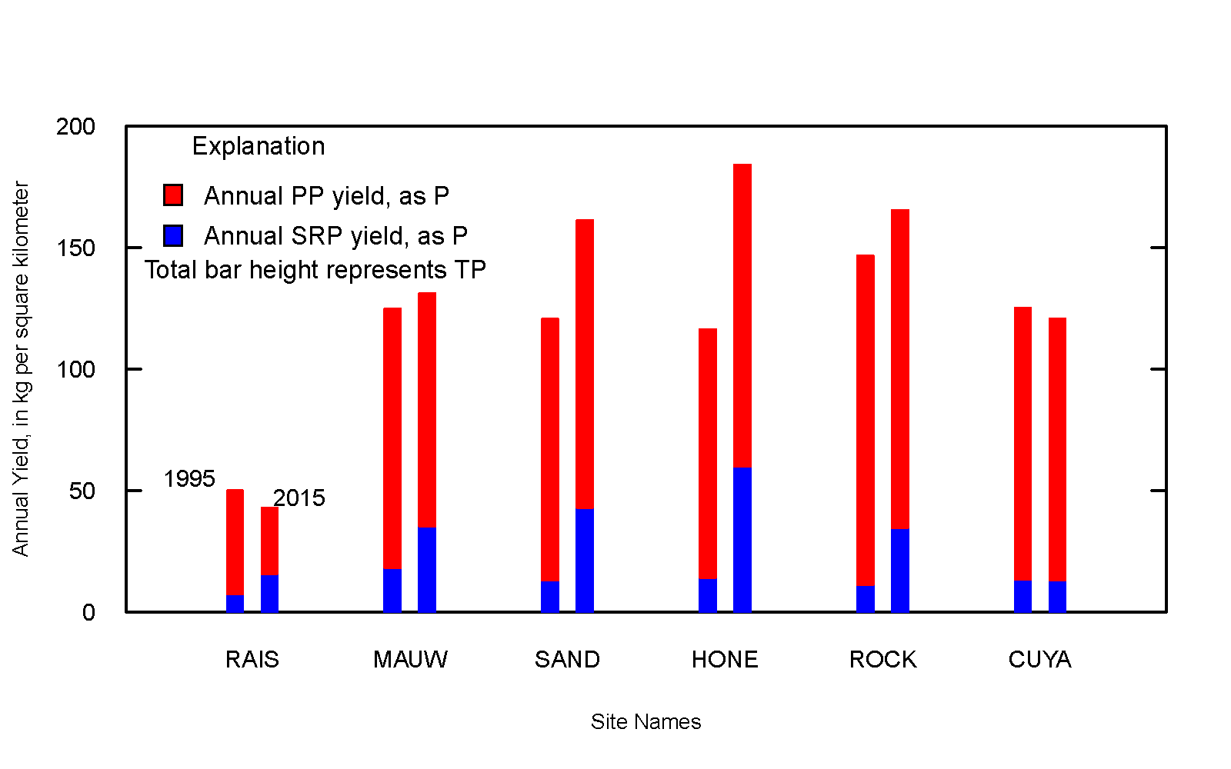
Changes in dissolved and particulate, by site

Slide 46
Topic 2: Point Source Upgrades
WRTDS is a smoother
We use it because we believe that in most cases the water quality changes are a result of many changes by many actors across the watershed
But, sometimes, that’s not way to think of it
Thus, “The Wall”
Data from before the wall don’t influence the model after it
Data from after the wall don’t influence the model before it
Implemented in EGRET 3.0 and EGRETci 2.0

Slide 47
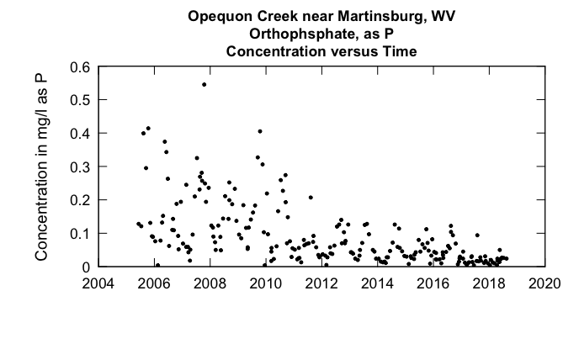

Slide 48
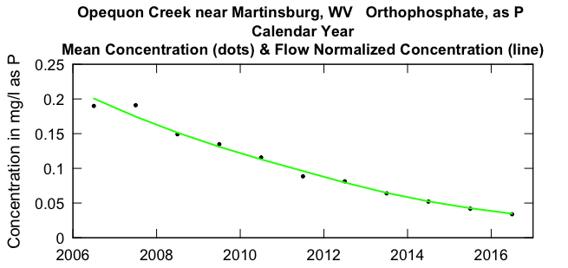
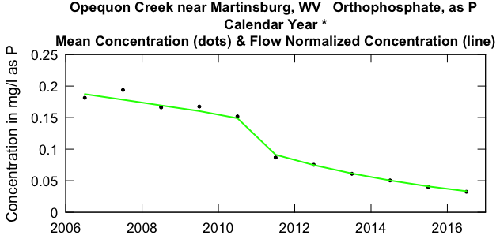
Results from runSeries, with wall at 2010-12-31
Standard results from modelEstimation

Slide 49
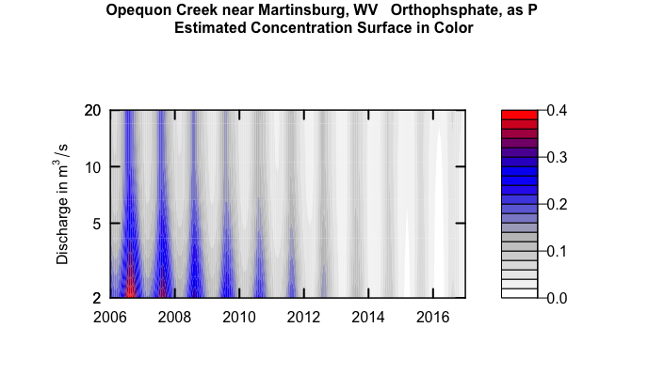
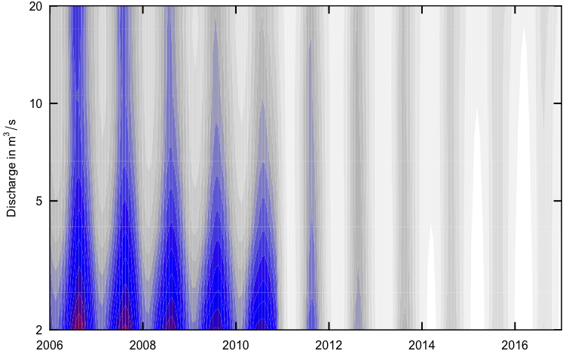
Opequon Creek near Martinsburg, Orthophosphate, as P
No Wall
Wall at 2010-12-31

Slide 50
Opequon Creek near Martinsburg, WV
Orthophsphate, as P
Water Year
Change estimates for
average of 2010 through 2017 minus average of 2006 through 2009
Sample data set was partitioned with a wall at 2009-12-31
Should we reject Ho that Flow Normalized Concentration Trend = 0 ? Reject Ho
best estimate of change in concentration is -0.109 mg/L
Lower and Upper 90% CIs -0.1412 -0.0627
also 95% CIs -0.1658 -0.0361
and 50% CIs -0.1215 -0.0997
approximate two-sided p-value for Conc 0.02
* Note p-value should be considered to be < stated value
Likelihood that Flow Normalized Concentration is trending up = 0.00495 is trending down = 0.995
Results from runGroupsBoot
Should we reject Ho that Flow Normalized Flux Trend = 0 ? Reject Ho
best estimate of change in flux is -0.0186 10^6 kg/year
Lower and Upper 90% CIs -0.02628 -0.00370
also 95% CIs -0.02752 0.00909
and 50% CIs -0.02131 -0.01637
approximate two-sided p-value for Flux 0.08
Likelihood that Flow Normalized Concentration is trending up = 0.0446 is trending down = 0.955
Upward trend in concentration is highly unlikely
Upward trend in flux is highly unlikely
Downward trend in concentration is highly likely
Downward trend in flux is highly likely

Slide 51
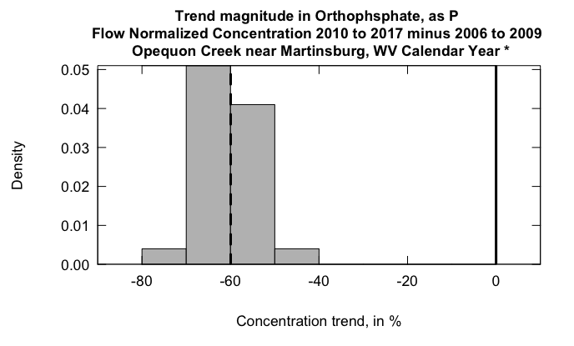

Slide 52
New and developing topics
Confidence intervals for annual flux
Improved estimates of actual concentrations and fluxes (WRTDS-K)
Trends in frequency of exceedance
Ephemeral streams
Uncertainty in reservoir mass balance

Slide 53
For references and these presentations and future developments see:
http://usgs-r.github.io/EGRET/

